Slide 1
Notes:
VIEW THIS POWER POINT IN PRESENTATION MODE FOR NARRARATION/VIDEO INSTRUCTION.

Slide 2
Notes:
Thank you to the pictured SkillsUSA sponsors for supporting the development of the SkillsUSA Framework and Career Essentials.

Slide 3
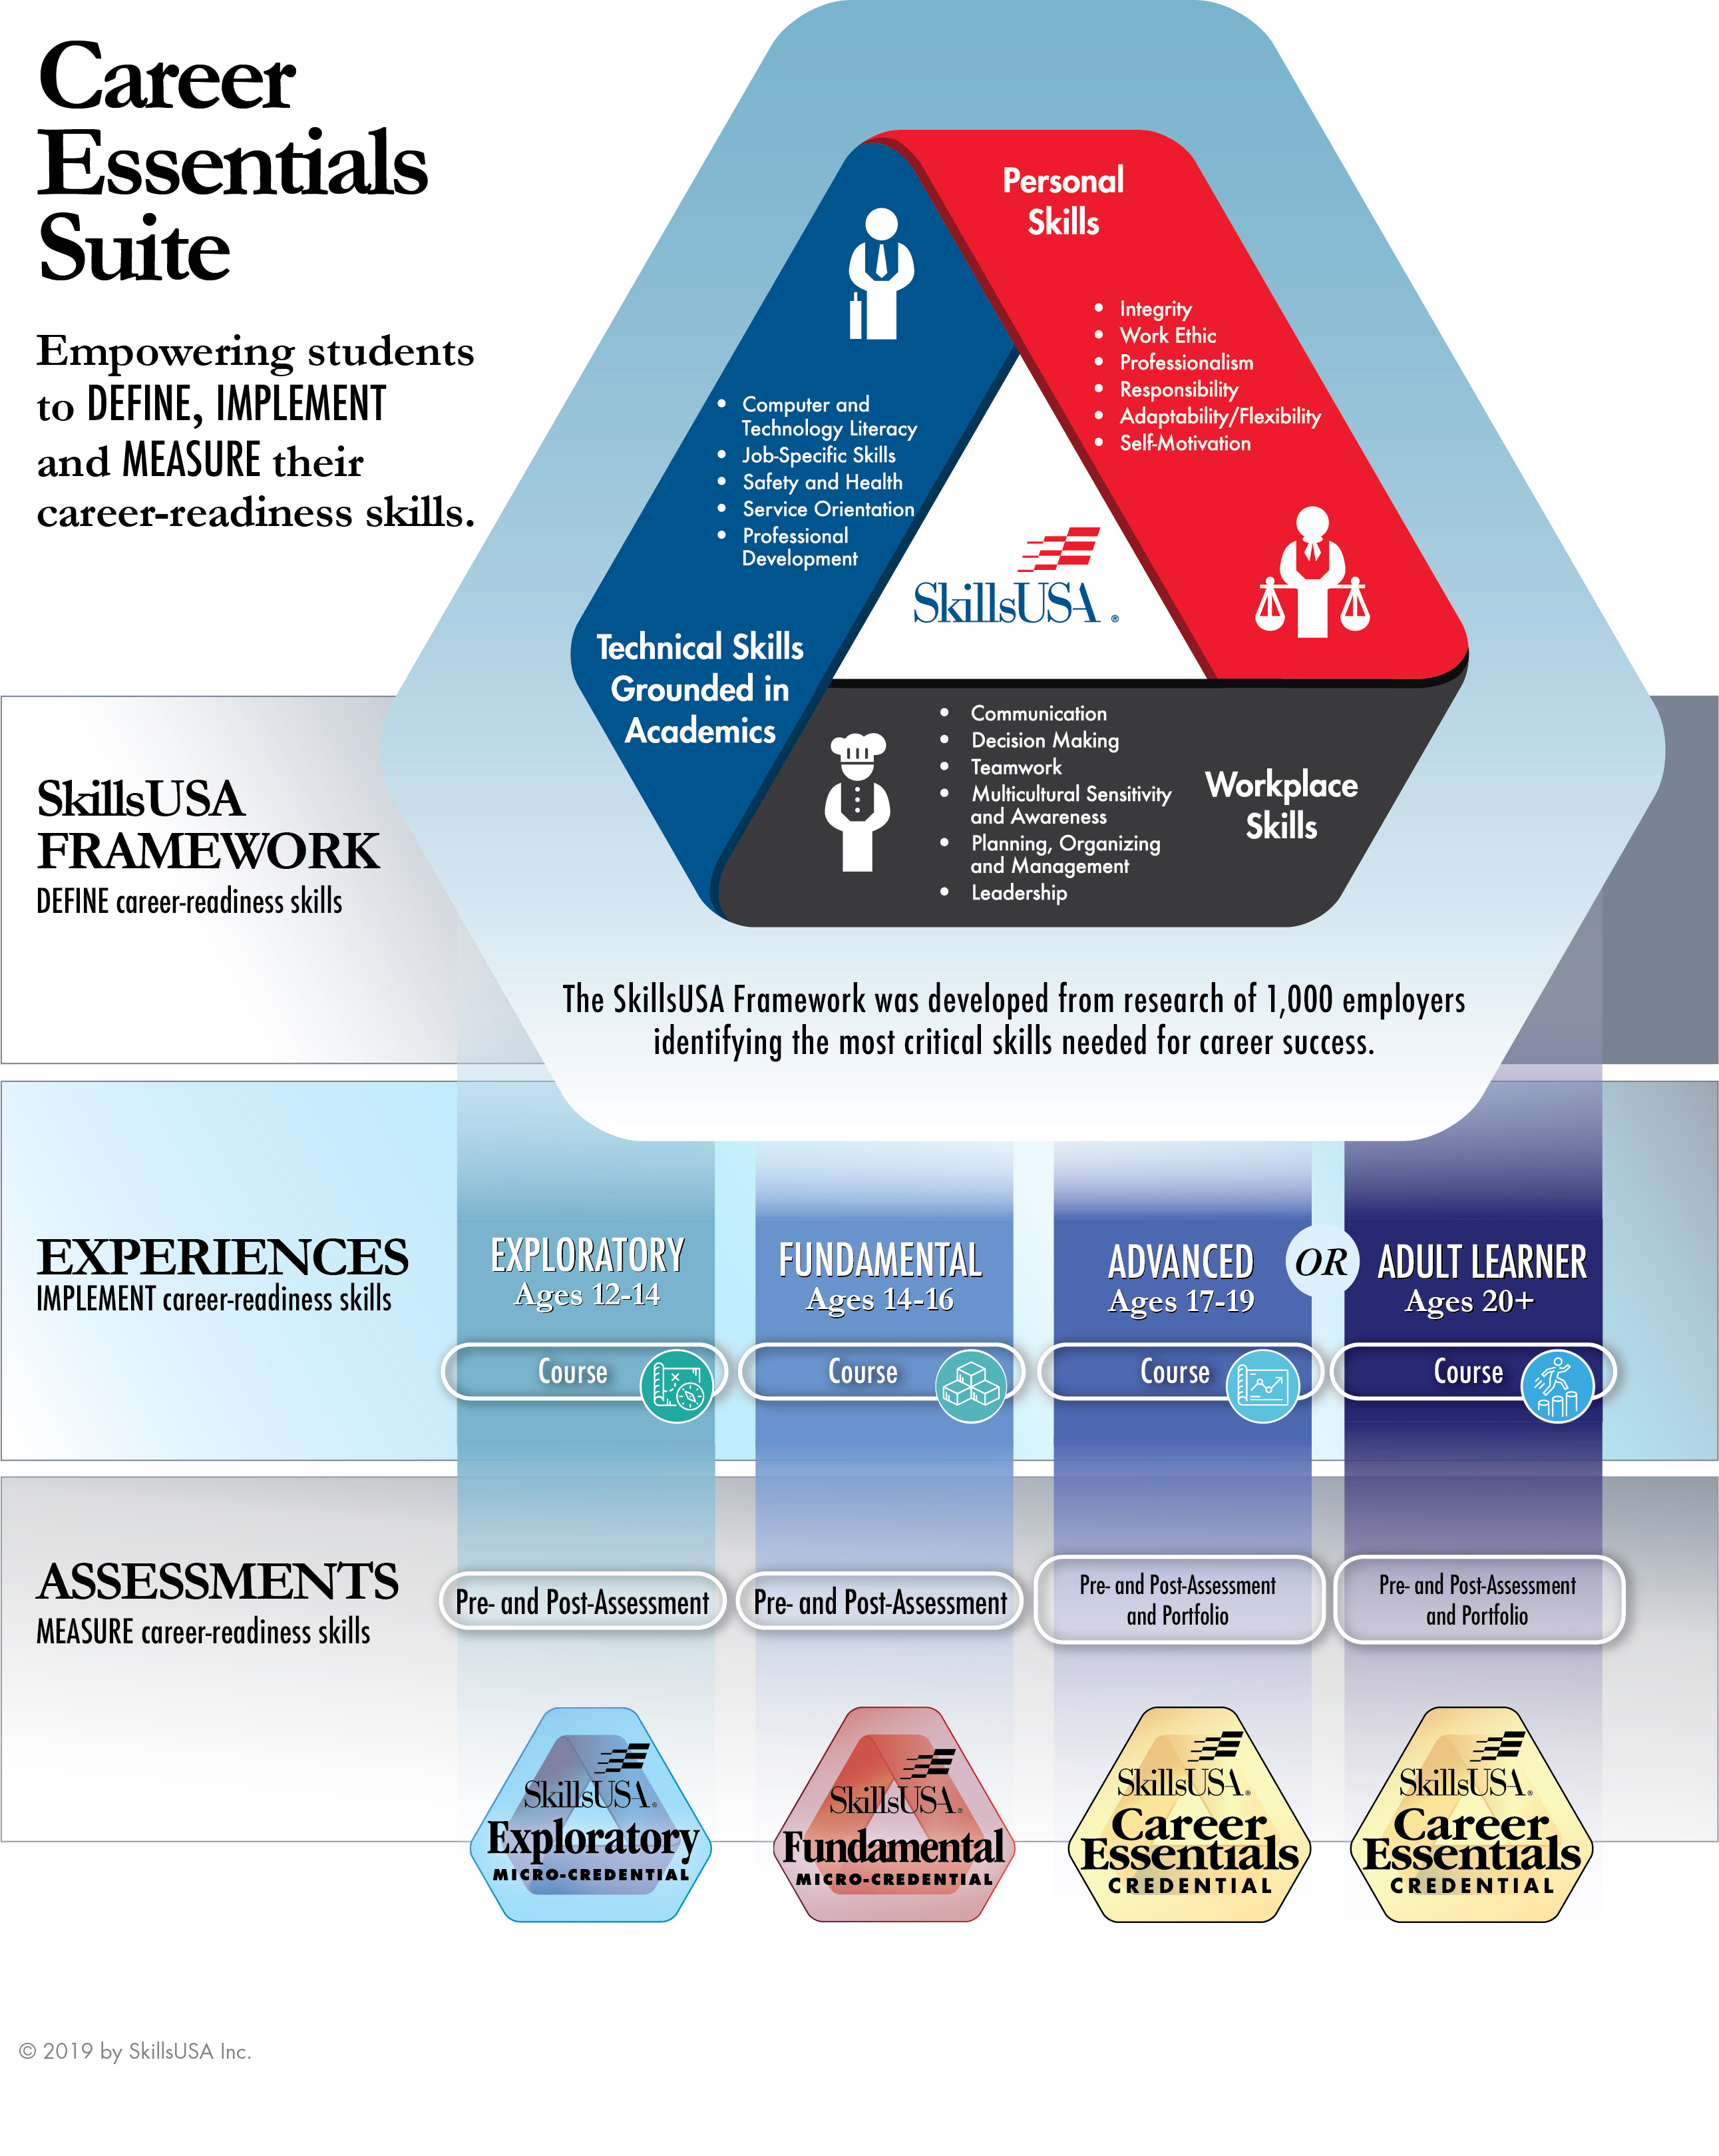
Notes:
Students have 24/7 online access to their course for 365 days from the first date of enrollment, allowing teachers to implement the course over any time period up to 1 year. Each course has the same objective: to define, implement and measure career-readiness skills of the SkillsUSA Framework. The course that you choose will depend on the age of your learners. Let’s break down each course option, from middle school to adult.

Slide 4
Notes:
The Exploratory Curriculum.

Slide 5
Notes:
The four units of the Exploratory Curriculum.

Slide 6
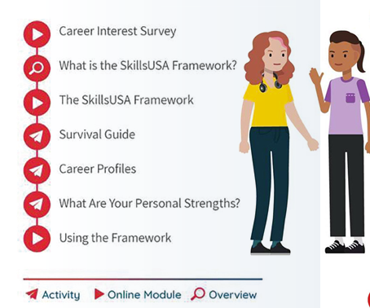
Exploratory Course: Unit 1
Notes:
Unit 1 of the Exploratory Curriculum.

Slide 7
Notes:
The Fundamental Curriculum

Slide 8
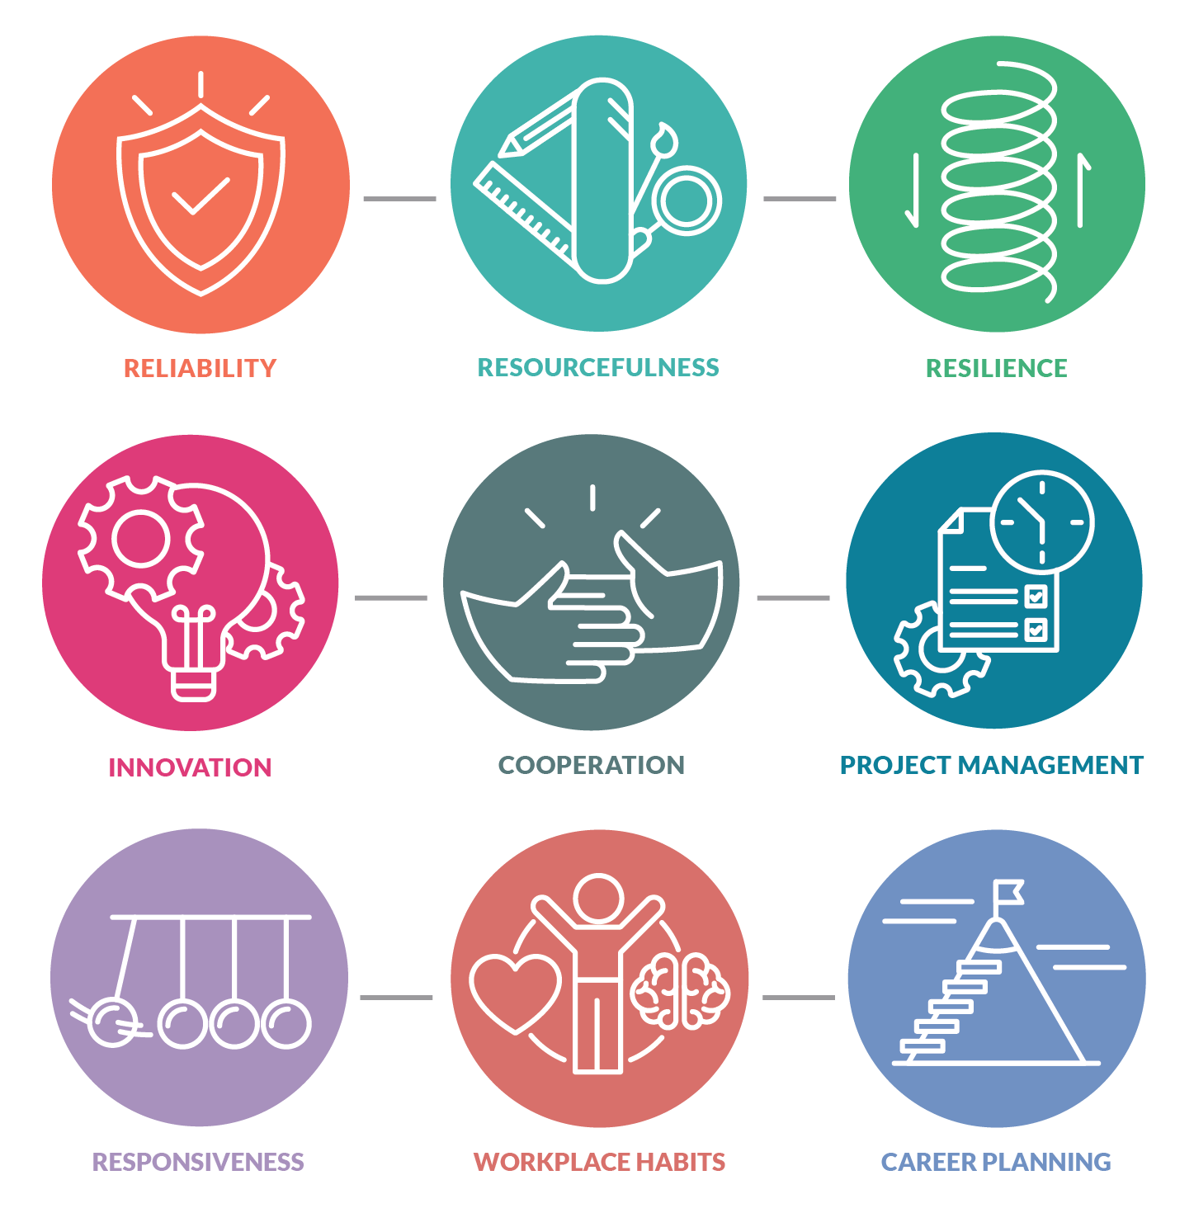
Notes:
Nine units in the fundamental course guide learners through combined skills in the SkillsUSA Framework.

Slide 9
Notes:
The Advanced and Adult Learner Curriculum

Slide 10
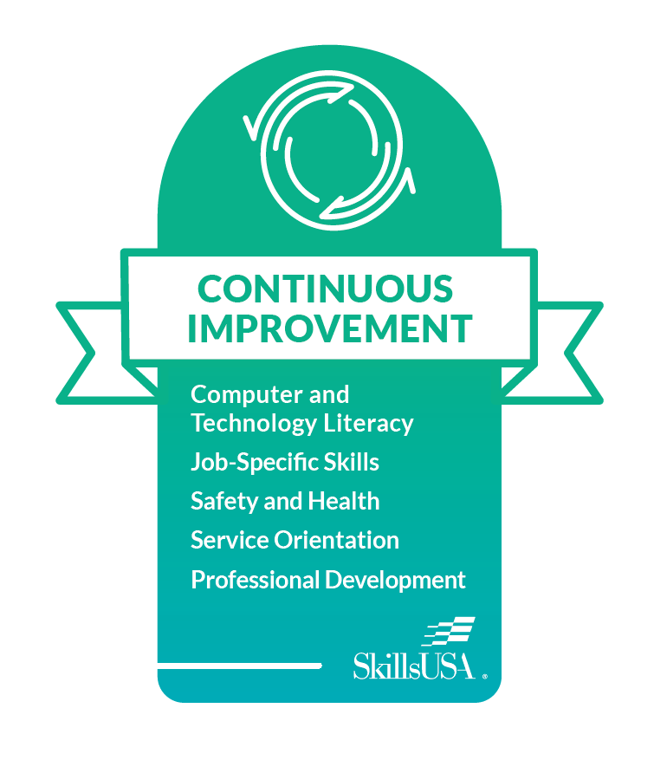
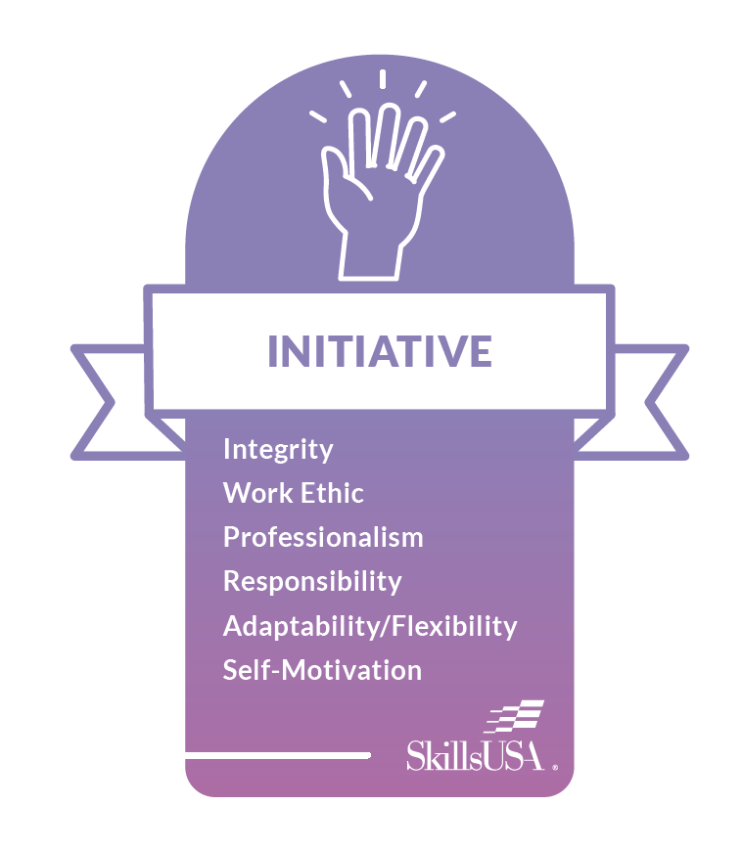
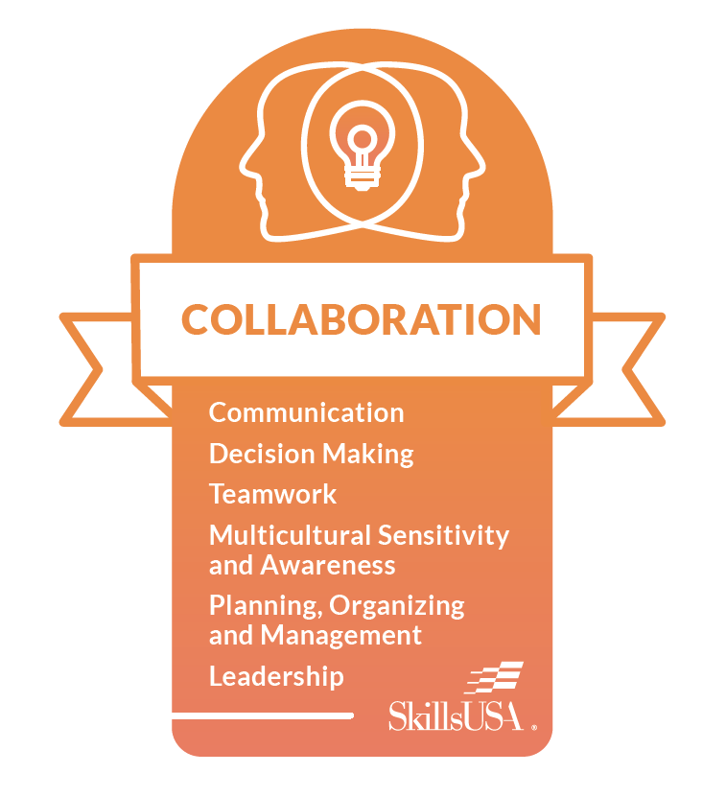
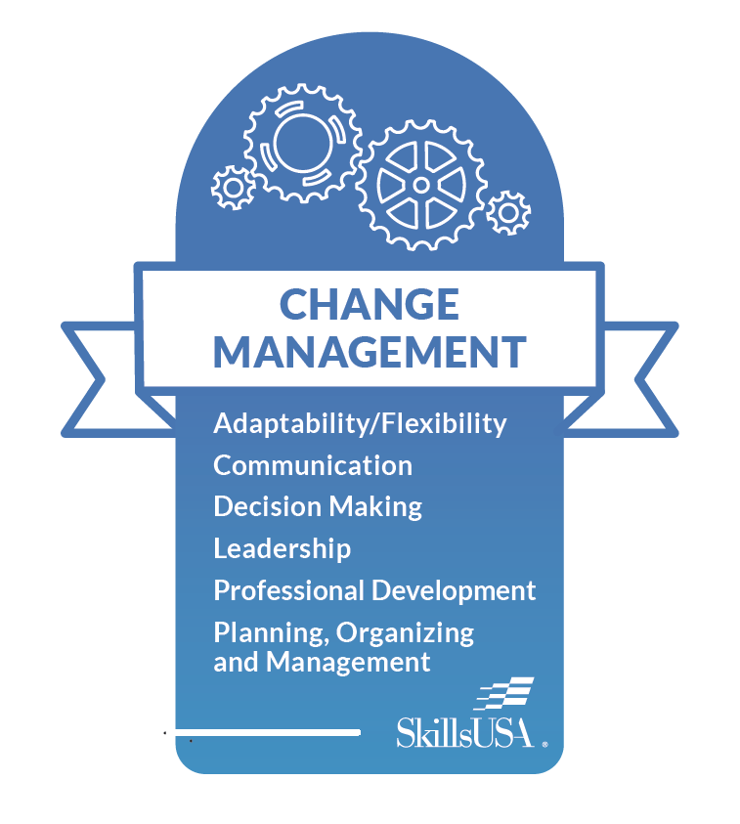
Notes:
The five units of the The Advanced and Adult Learner Curriculum

Slide 11
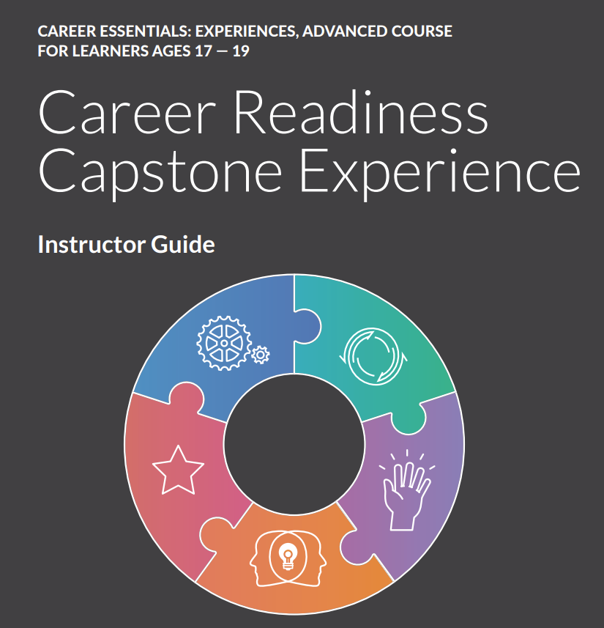

Slide 13
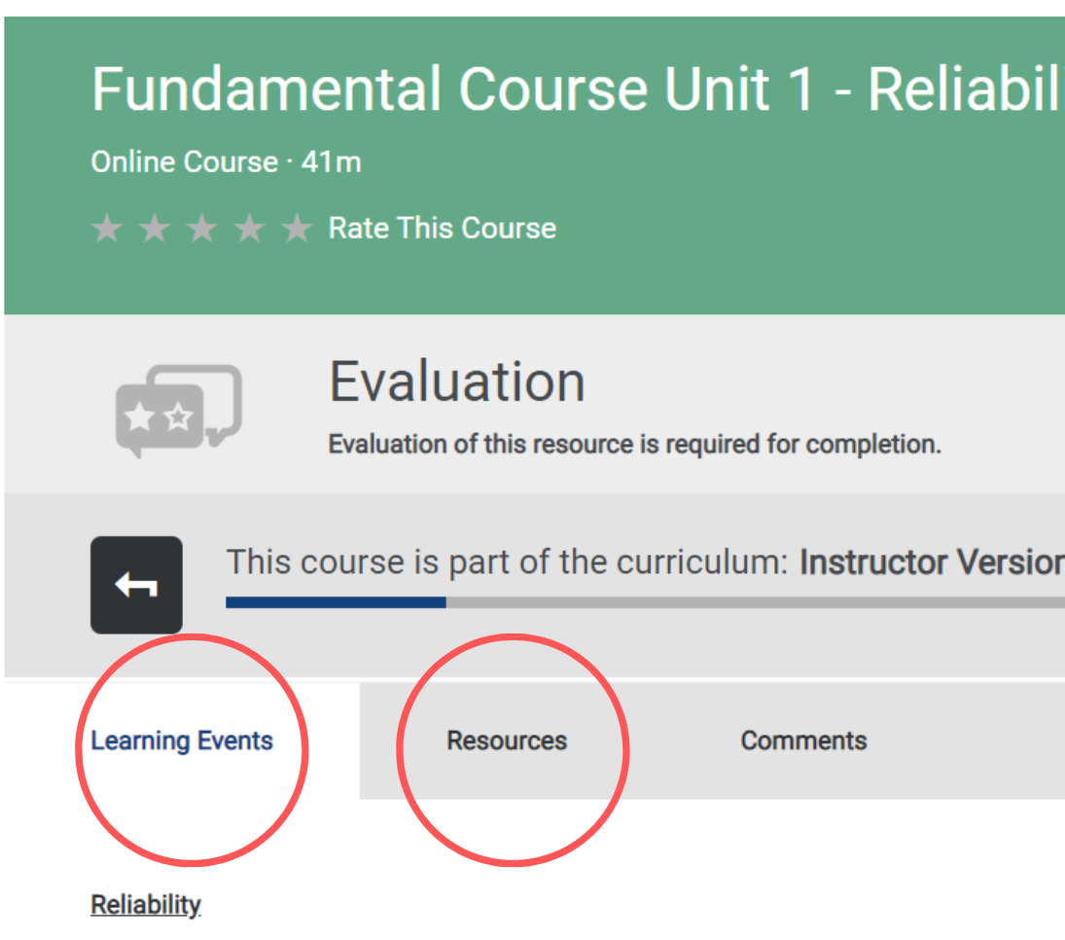
Notes:
Each Career Essentials course contains project activities or “assignments” that are completed offline. Instructors choose how students submit their completed project activities. For example, students may hand in their project activities as printed documents, or send them to the instructor via via email or a shared drive. Instructors verify student completion of project activities through their Admin Dashboard in Absorb. How instructors verify completion depends on the course. Take a moment to review this chart for a summary of how project activities are delivered in each course.

Slide 14
Career Essentials Suite Options
Exploratory Curriculum (ages 12-14) Up to 25 hours student time
Fundamental Curriculum (ages 14-16) About 23 hours student time (required project activities only) **A bank of optional project activities is provided. Instructors may choose to add additional project activities if desired. Advanced Curriculum (ages 17-19) About 18 hours student time (required Capstone Artifacts only) **A bank of optional project activities is provided. Instructors may choose to add additional project activities if desired.
Adult Learner Curriculum (ages 20 and above) See Advanced Curriculum
Notes:
Instructors can choose from these courses, depending on the age of their learners.

Slide 15
Career Essentials Pricing
View all pricing information at careeressentials.org/pricing/

Slide 16
Your Implementation Schedule
After selecting your curriculum, your next step is to establish a schedule that learners will follow to complete their coursework. Implementation is customizable to your unique teaching situation!

Slide 17
Establish an Implementation Period
What date will you begin?
What date will you finish? How many weeks fall in between those two dates?

Slide 18
Sample 11-Week Implementation Plan Advanced Curriculum
Implementation Weeks (30 minutes in morning, Mon. – Fri.) | Completion Goals
Week 1 and Week 2 | Introduction, Pre-Assessment, Unit 1
Week 3 | Unit 2 (*Shortest Unit in Advanced Curriculum)
Week 4 and Week 5 | Unit 3
Week 6 and Week 7 | Unit 4
Week 8 and Week 9 | Unit 5 and Post-Assessment
Week 10 | Unit 6 (Refine Professional Portfolio and Complete Reflection Experience)
Week 11 | Mock Job Interviews

Slide 19
Keeping Students on Track
With Unit Project Planning Tables

Slide 20
Monitoring Student Progress and Performance – Part 1

Slide 21
Monitoring Student Progress and Performance – Part 2

Slide 22
Placing Your Order

